Slide 1
Smart Unmanned Store: YOLO AI Abnormal Behavior Detection
& Alert App
Team A
민유진(32221598), 윤택민(32217495), 최예림(32224684),

Slide 2
Table of Contents
I. Introduction
II. Main Body
III. Conclusion
1. Background
2. Problem Definition
3. How to solve Problem
4. Expected Effects
1. Development Tools
2. YOLO Design
3. Application Design
4. Environment Setup
1. YOLO Model
2. Application

Slide 3
I. Introduction

Slide 4
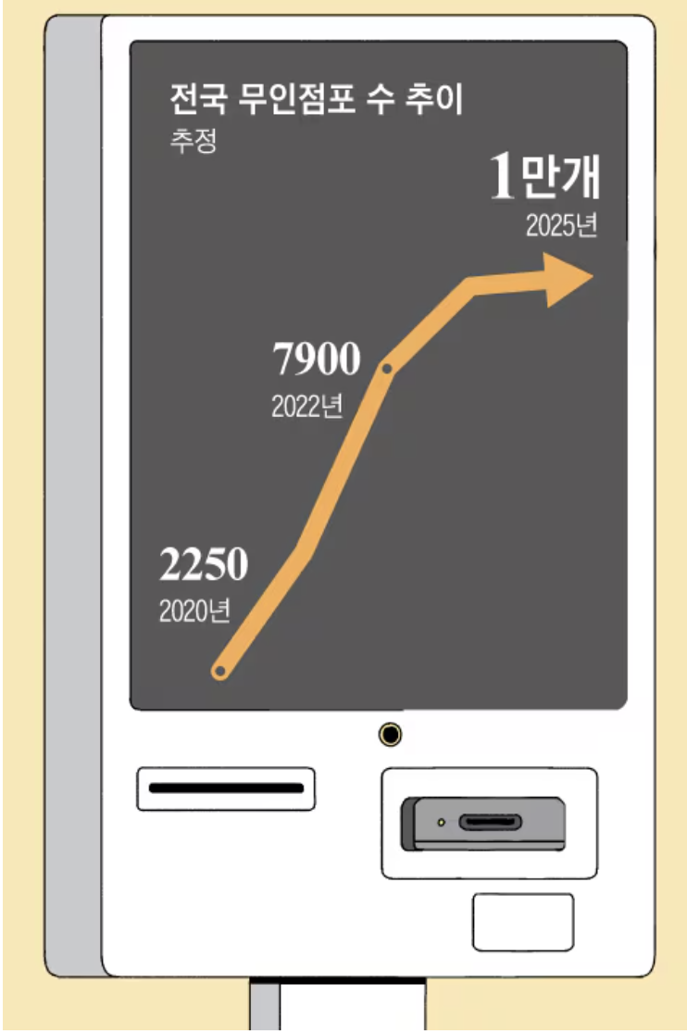
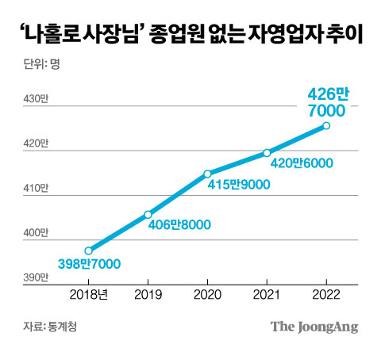
Background
Increasing Unmanned stores
April 2025, unmanned stores exceeded 10,000
Main Reasons for the surge:
Reduce labor costs
Reduce initial investment costs

Slide 5
Background
Increasing Unmanned stores
April 2025, unmanned stores exceeded 10,000
Main Reasons for the surge:
Reduce labor costs
Reduce initial investment costs
However, due to the lack of permanent staff,
serious side effects occur and exposure to crime occurs

Slide 6
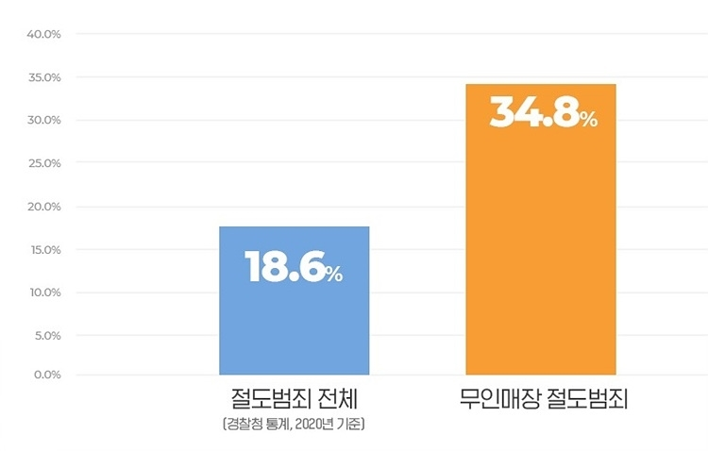
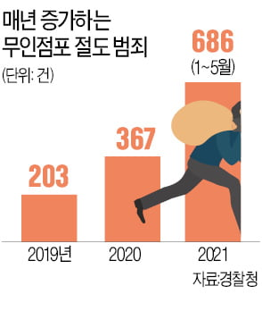
Problem Definition
CCTV installed in unmanned stores is not effective in preventing crime,
and the crime rate is increasing every year.

Slide 7
How to solve Problem
Abnormal Behavior Detection and Notification
Provide continuous monitoring
Instant notification when abnormal behavior is detected
Automatically save evidence
Viewing only sections with detected abnormal behavior
Increased remote management efficiency
Remote management without needing to be physically present at the store

Slide 8
Expected Effects
Crime prevention and damage minimization
crime prevention and immediate response through real-time notifications
Improve operational efficiency
identify risk situations without 24 hour store monitoring
Creating a safe store environment
preventing major accidents with notifications to create a safe environment
Contribute to solving social problems
providing practical solutions to crimes related to unmanned stores

Slide 9
II. Main Body

Slide 10


Development Tools
UX/UI: Figma
Front: Flutter
Backend: Python, Fast API, Unicorn
Database: SQLite
YOLO: Python, YOLO v8
Collaboration Tools: Github, Notion

Slide 11

YOLO Design
Train Dataset

Slide 12
YOLO Design
Train Dataset
Dataset | Contents
Indoor (convenience store, store) purchasing behavior data | training data for normal store activity patterns
Indoor (convenience store, store) human abnormal behavior data | Trained to detect in store abnormal behavior using the Yolo model

Slide 13

YOLO Design
Model

Slide 14
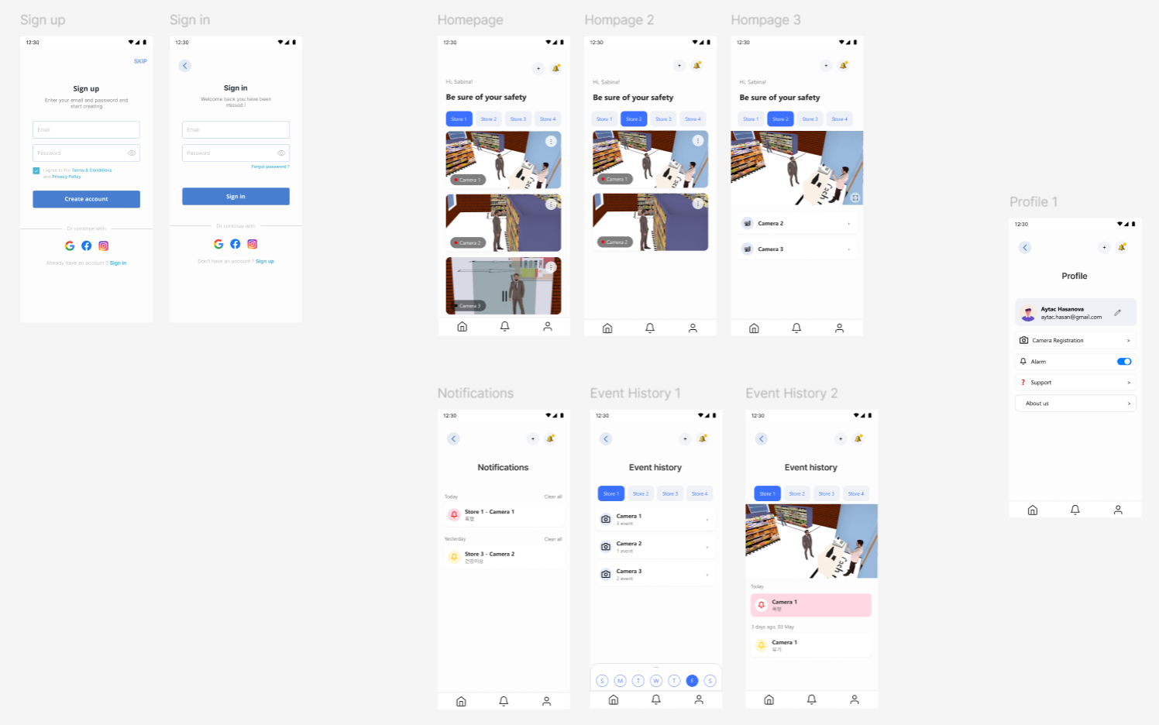
Application Design
UX/UI

Slide 15
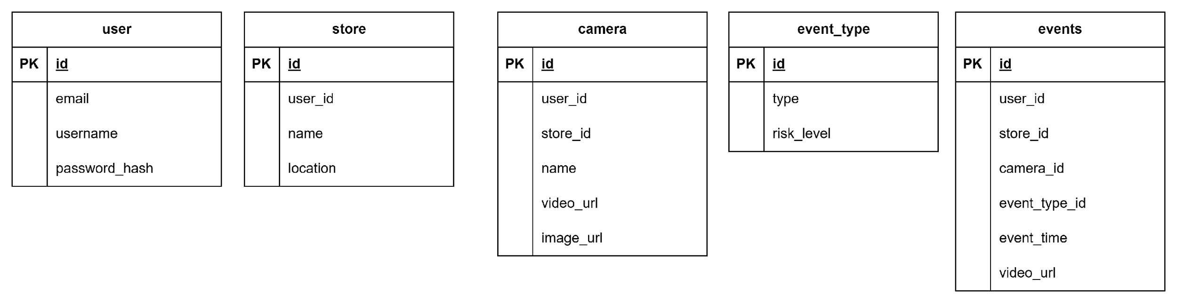
Application Design
Database

Slide 16







Environment Setup
Best.pt

Slide 17
III. Conclusion

Slide 18
YOLO Model
Train Dataset
Dataset | Classes | size
Indoor (convenience store, store) purchasing behavior data | Moving, Selecting, Purchasing | Train: 35,119 Val: 4,267
Indoor (convenience store, store) human abnormal behavior data | Fall, Smoking, Theft, Fight | Train: 5,322 Val: 658

Slide 19
YOLO Model
Data Preprocessing
Images
Labels
MP4 Data
XML Label
Frame Extraction
XML Parsing
Image Save
YOLO Label Generation
Class Filtering & ID Mapping

Slide 20
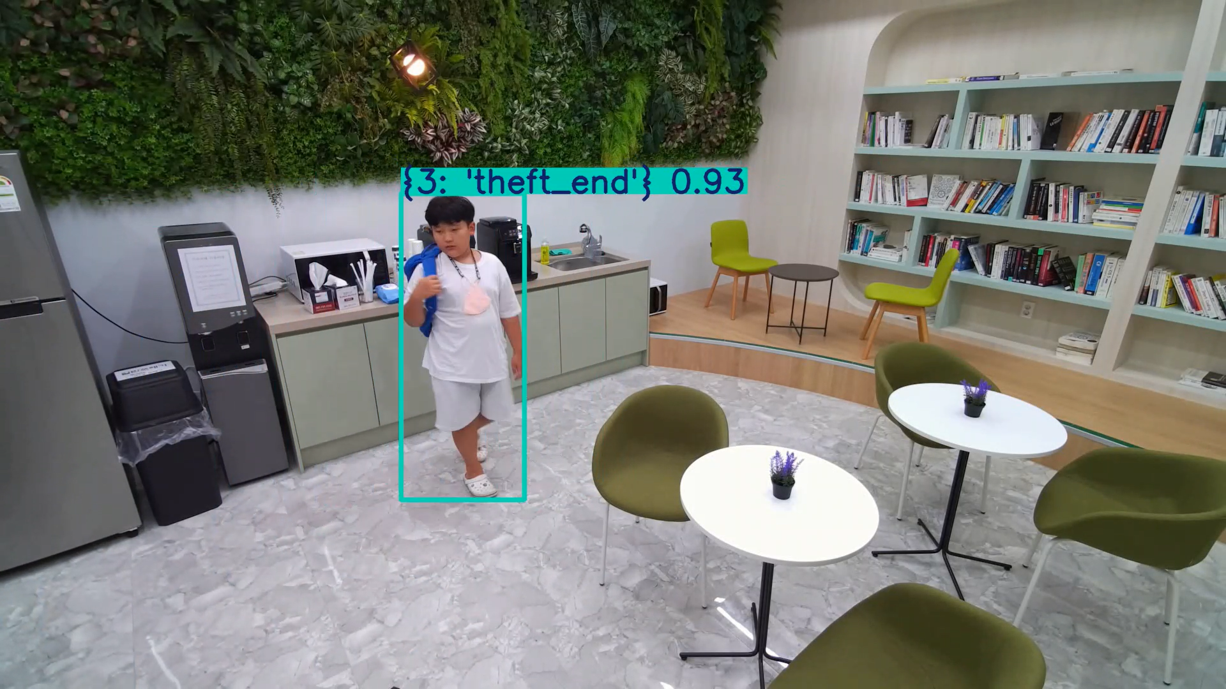
YOLO Model
Video Detection

Slide 21
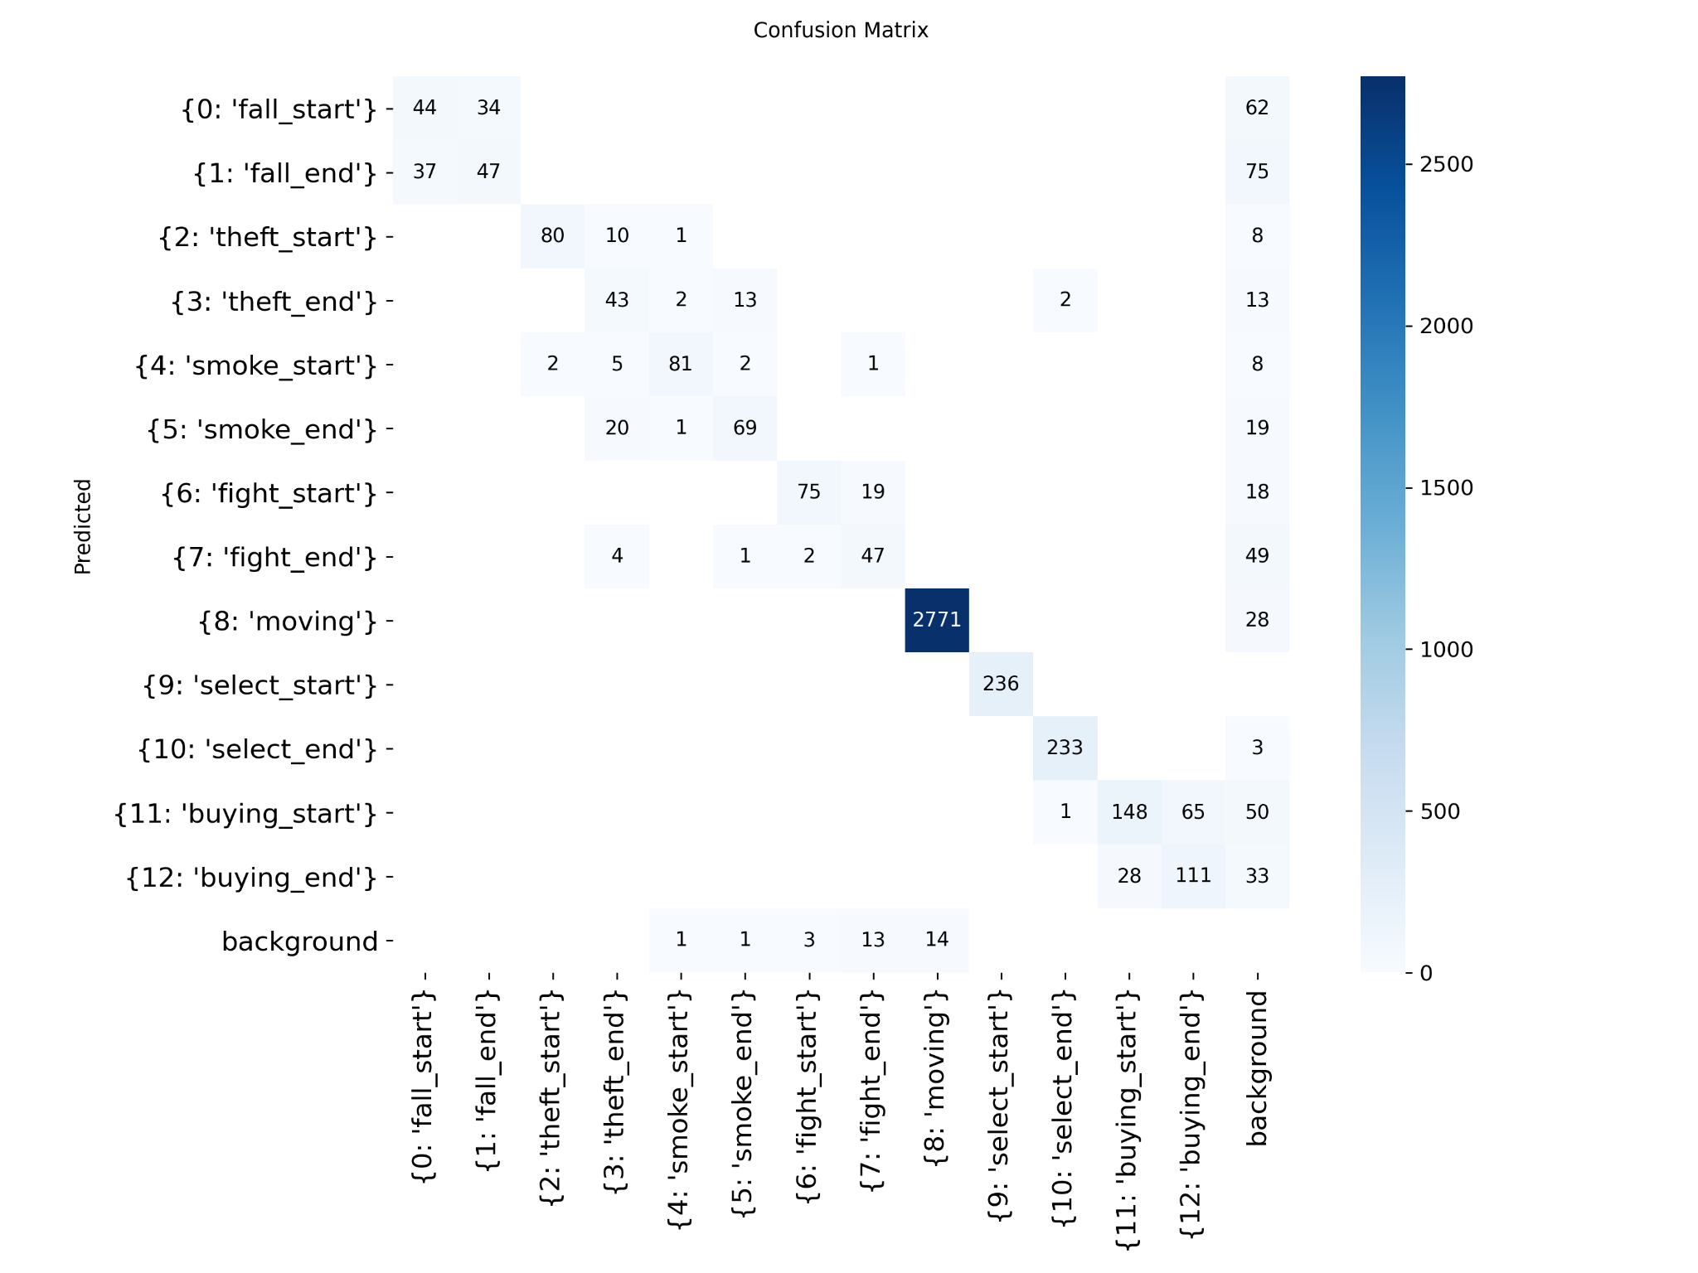
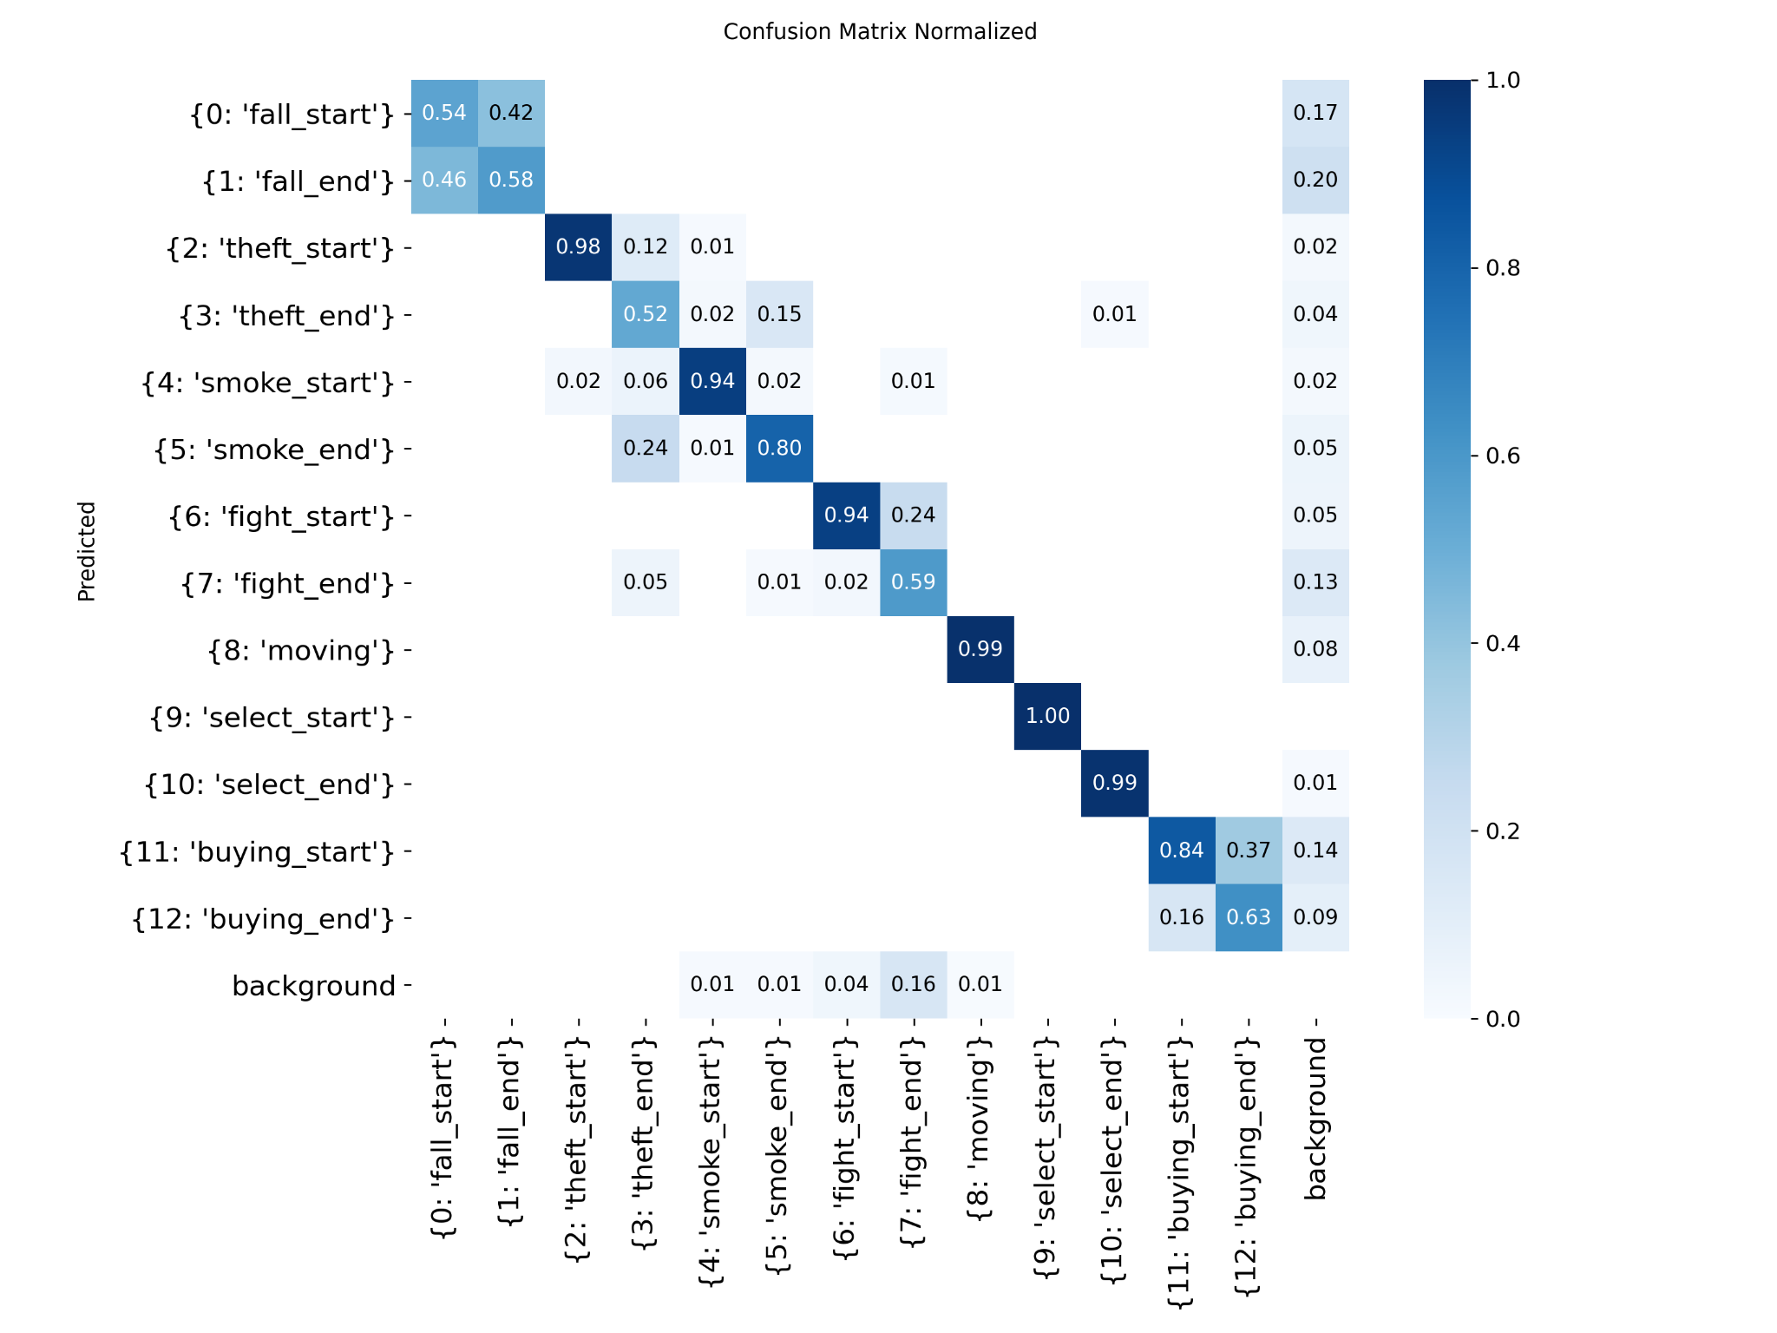
YOLO Model
Model Performance

Slide 22
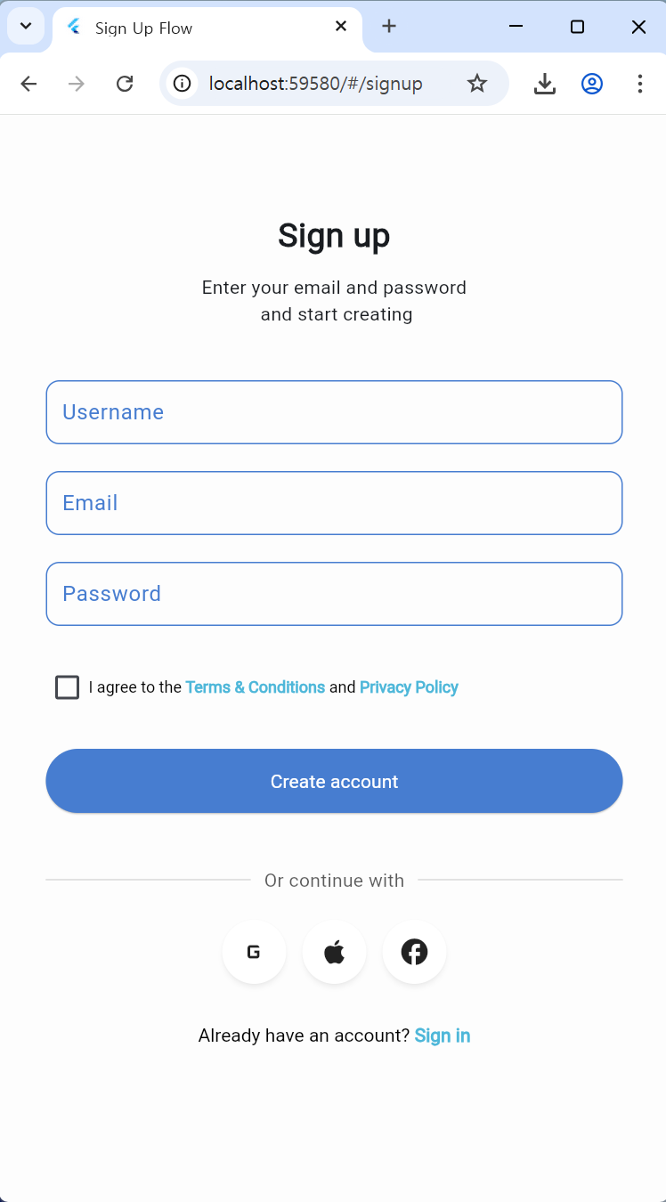
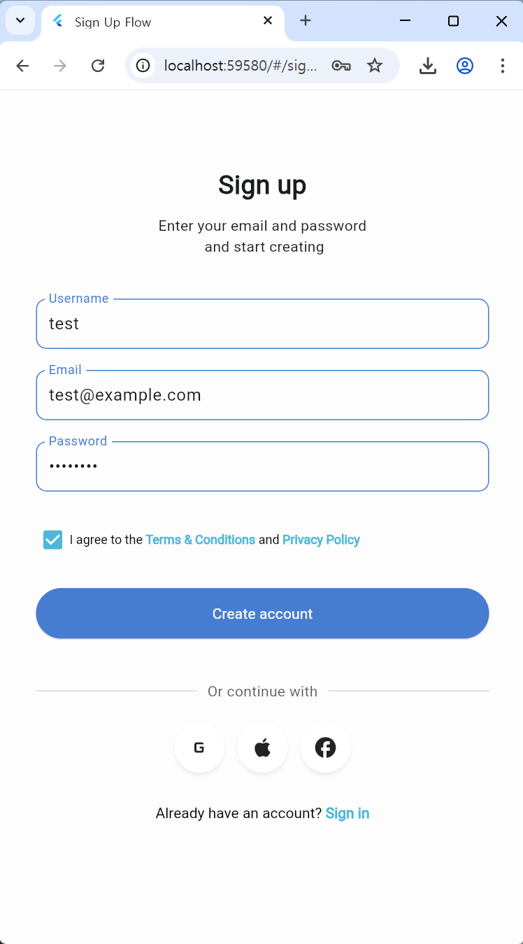
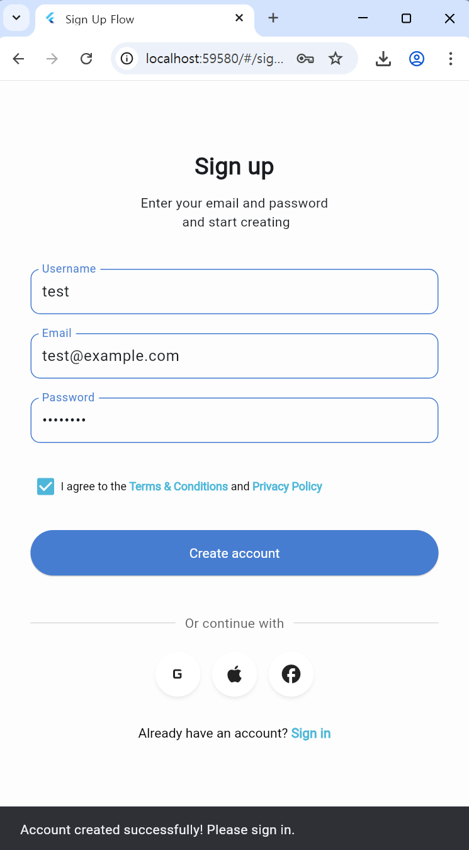
Application - Sign Up

Slide 23
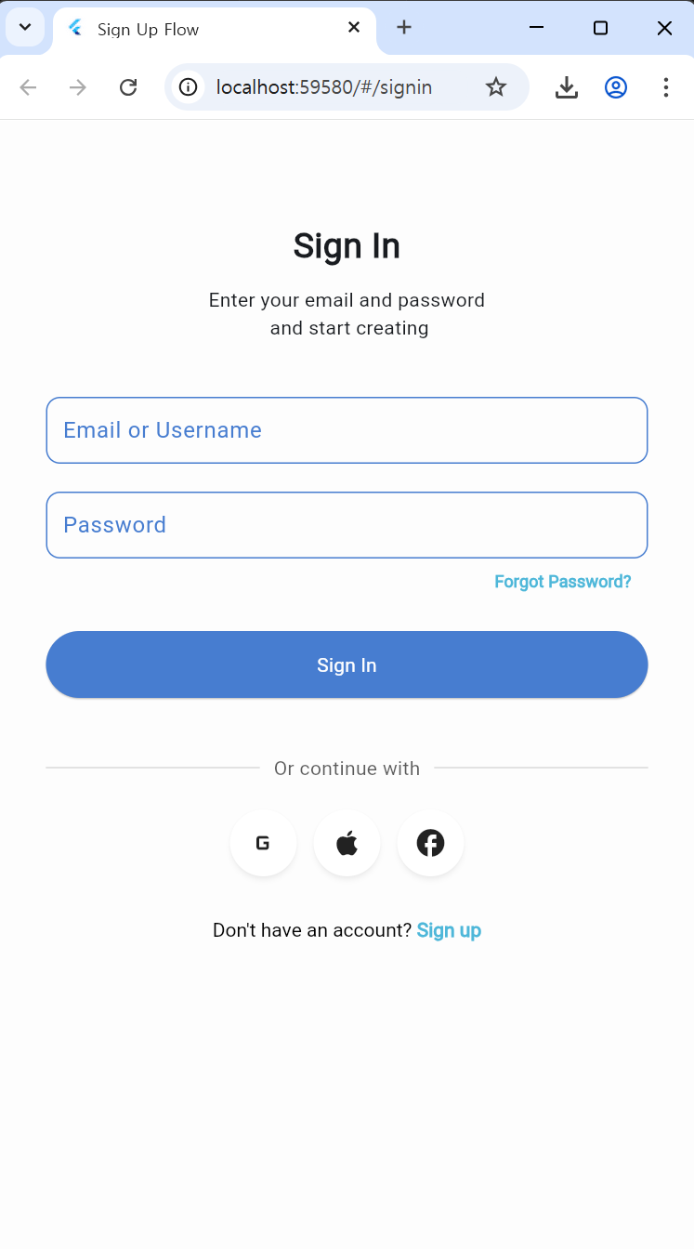
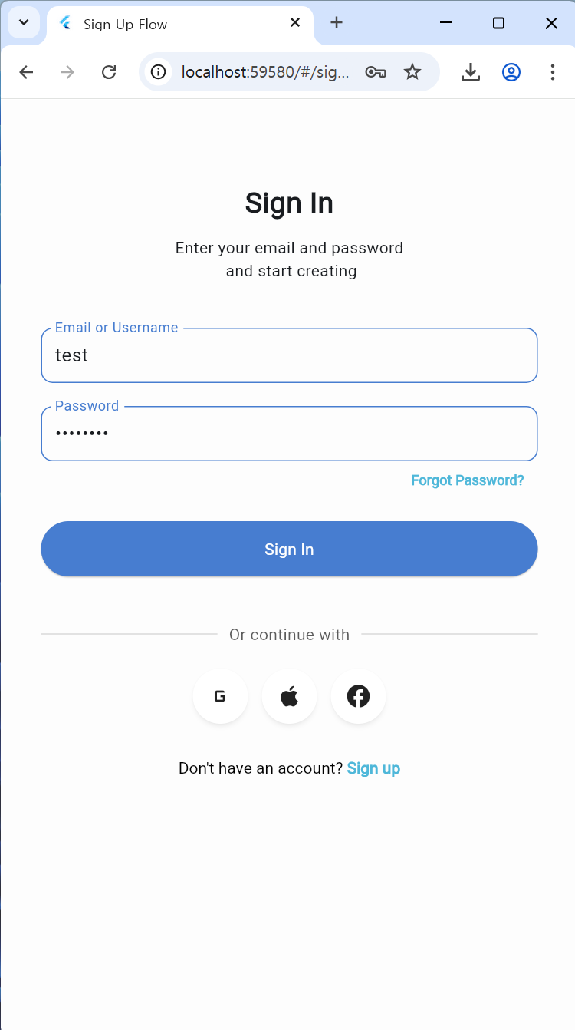
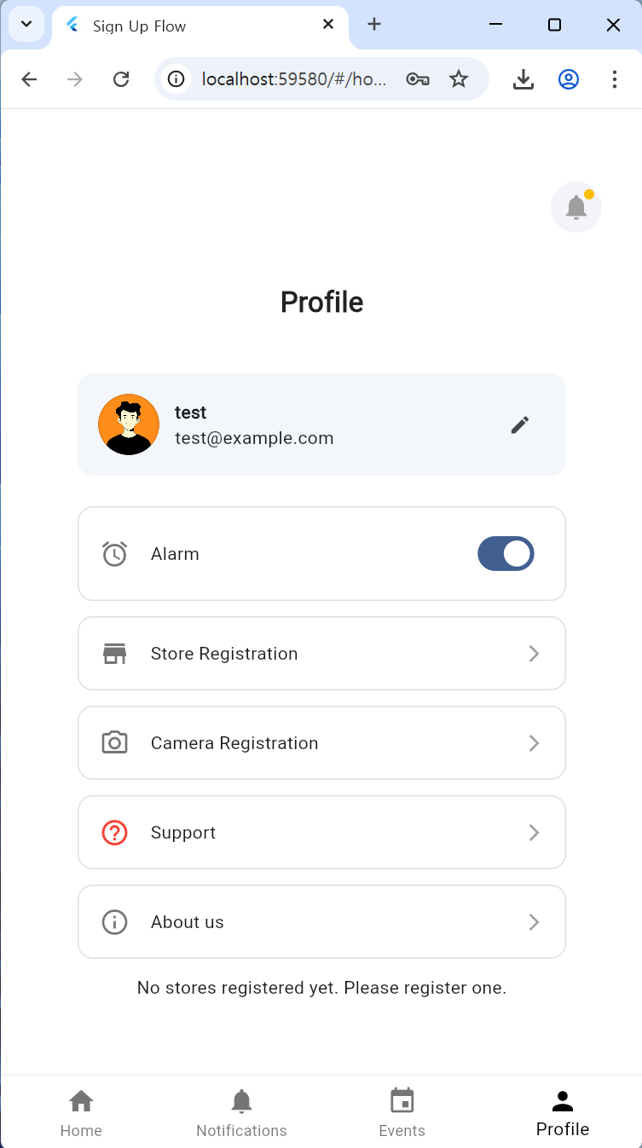
Application - Sign In, Profile

Slide 24
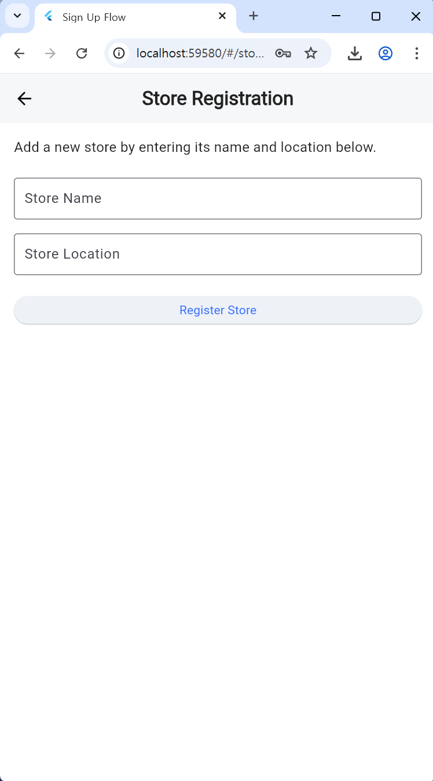
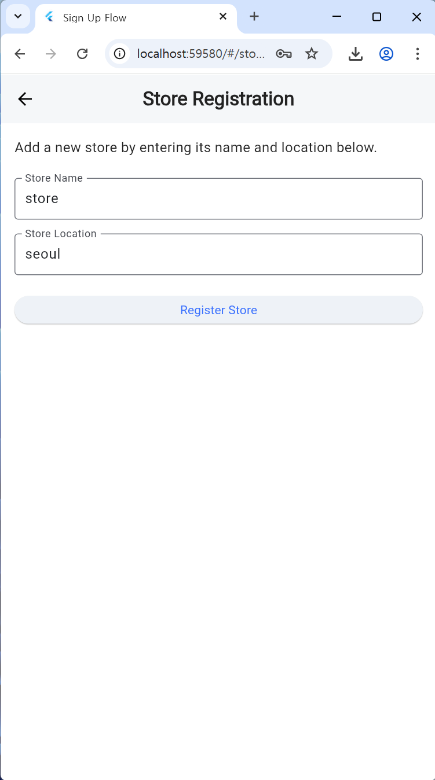
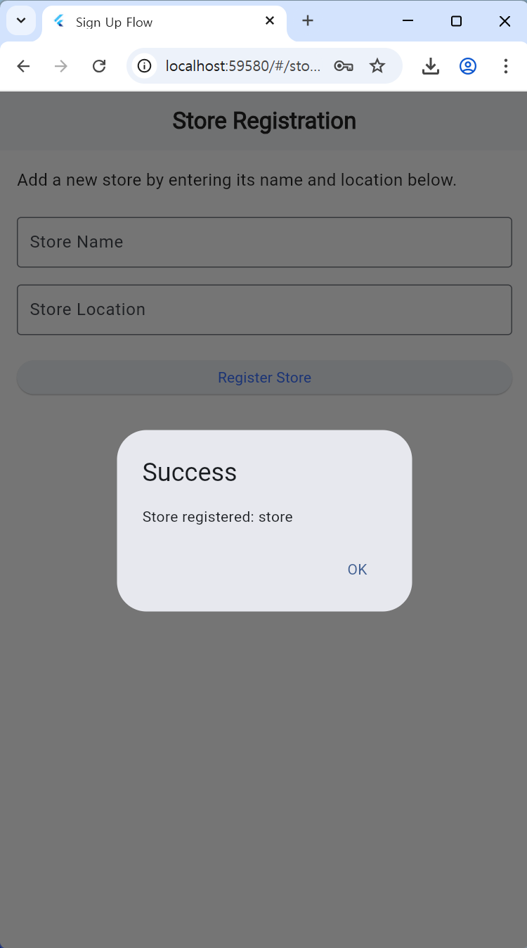
Application - Store Registration

Slide 25
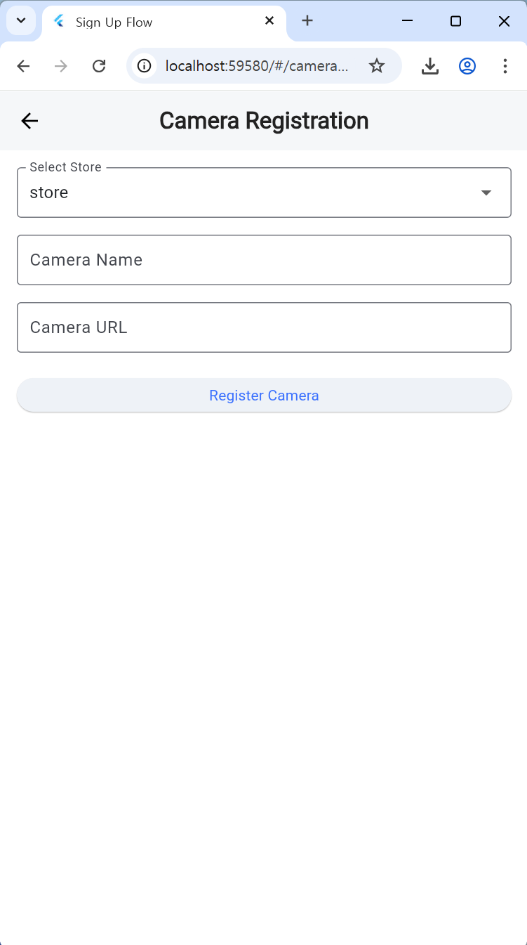
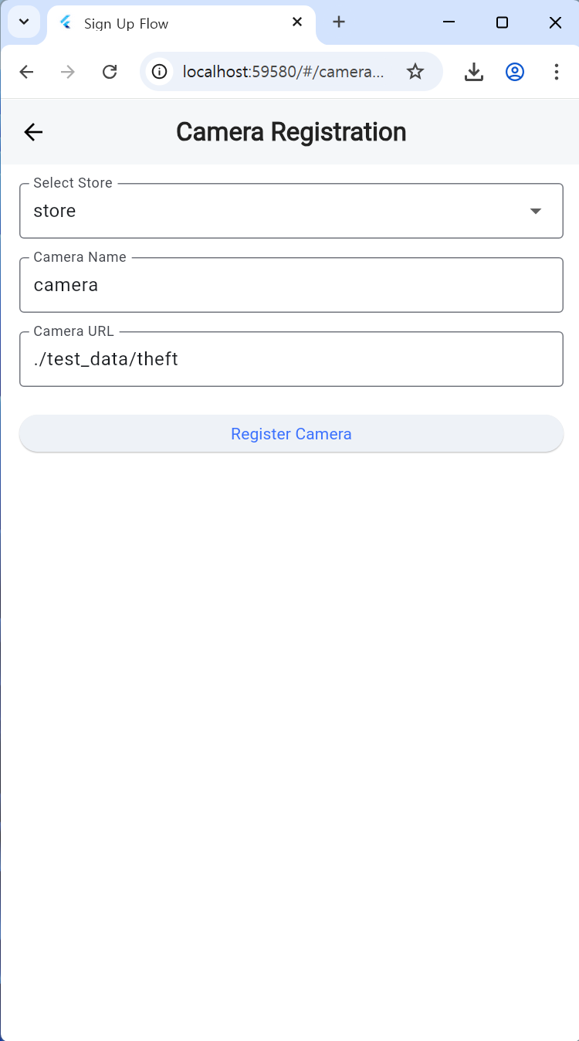
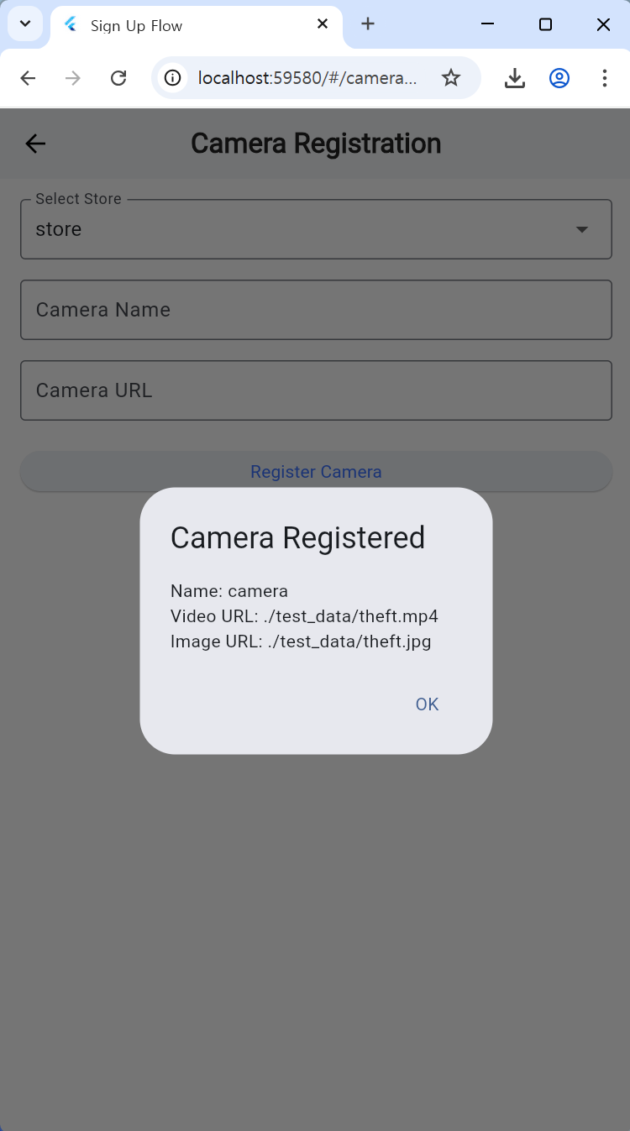
Application - Camera Registration

Slide 26
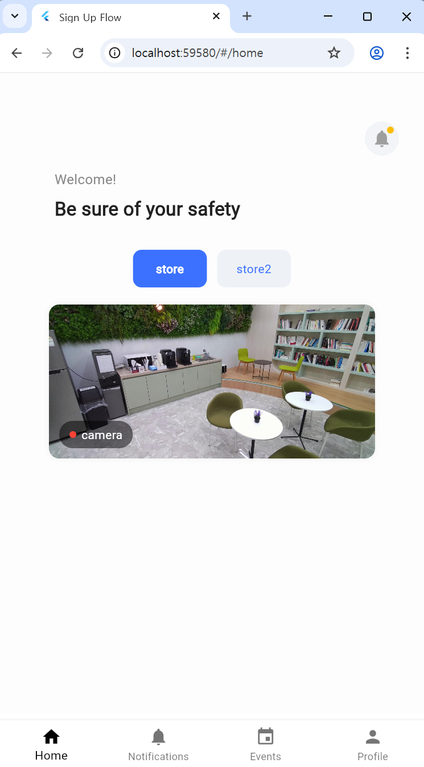
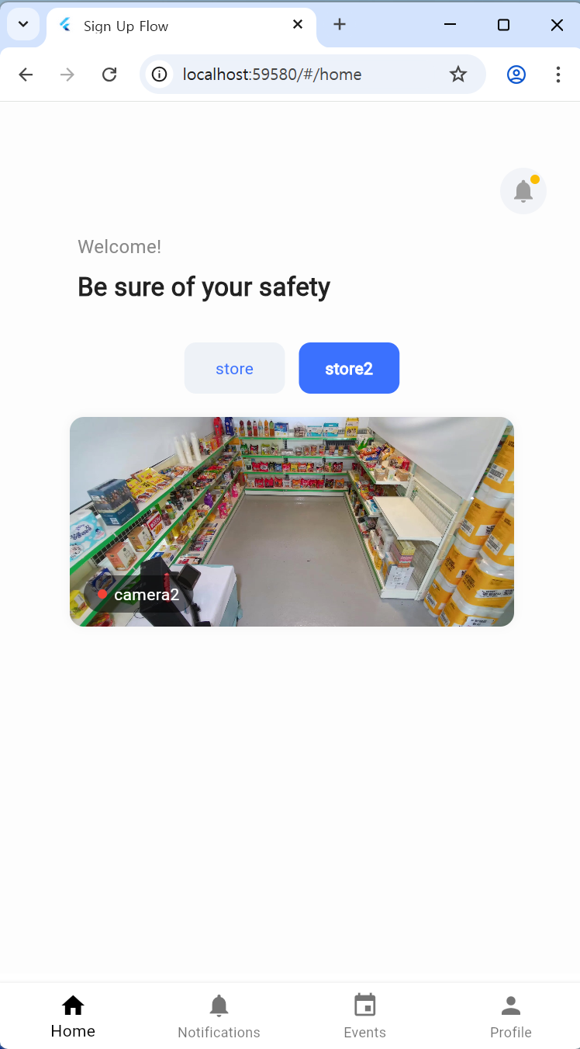
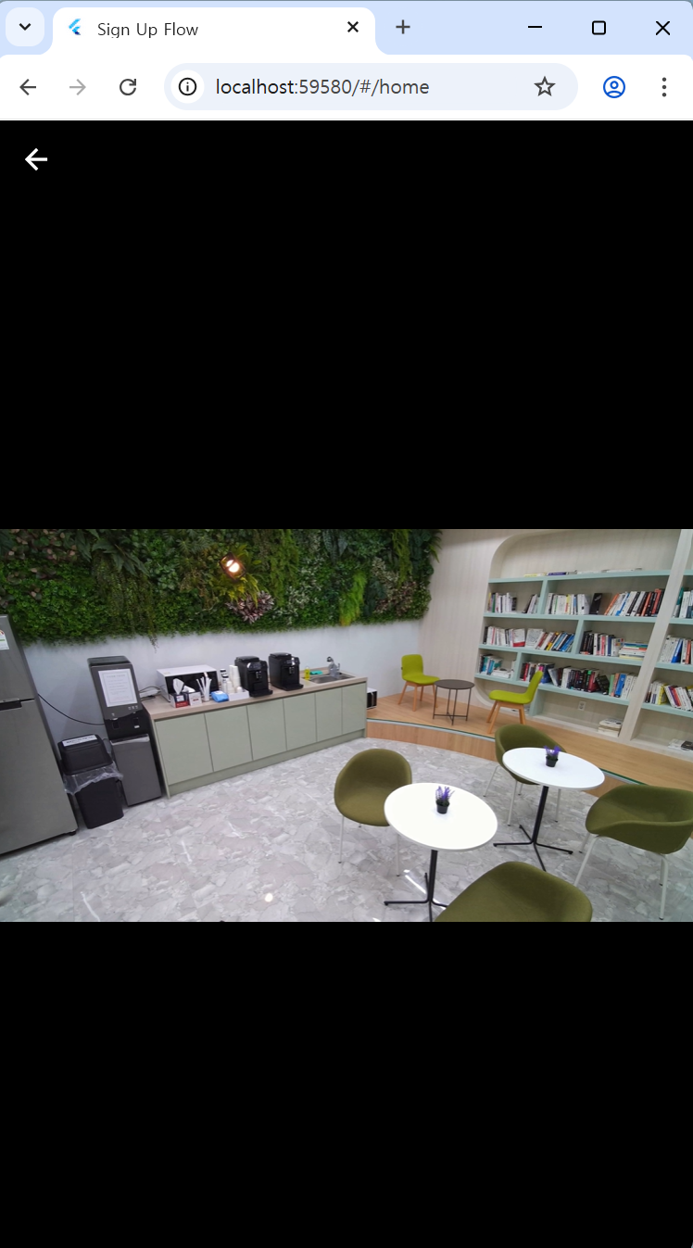
Application - Home

Slide 27
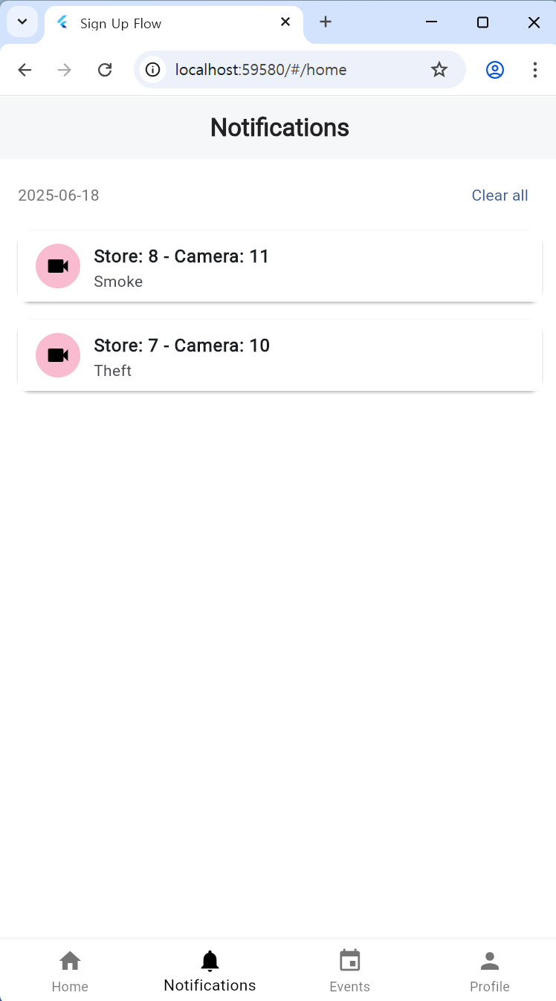
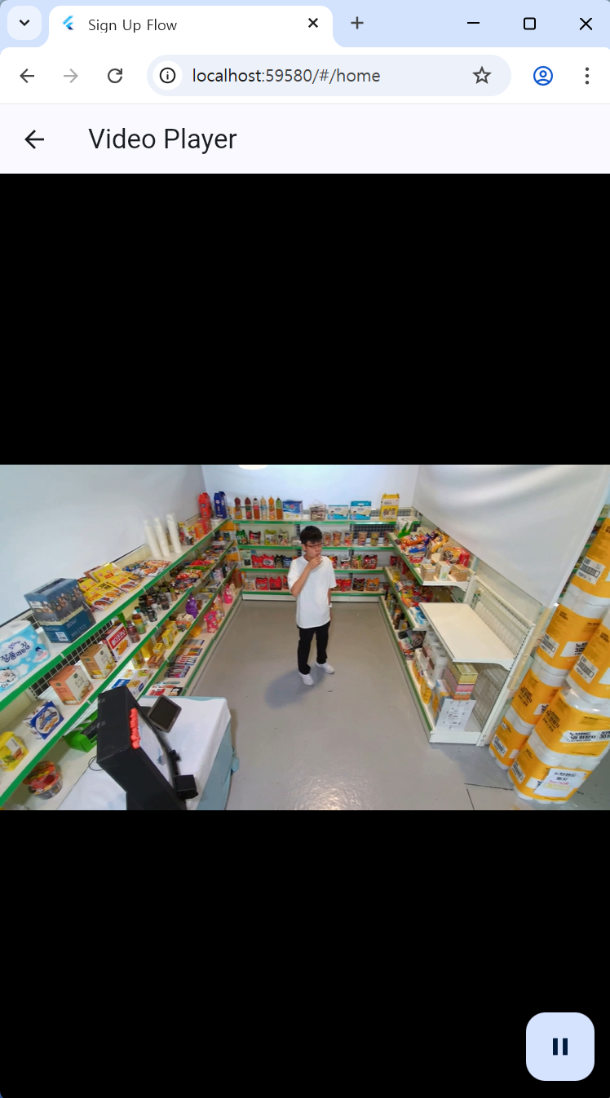
Application - Notifications

Slide 28
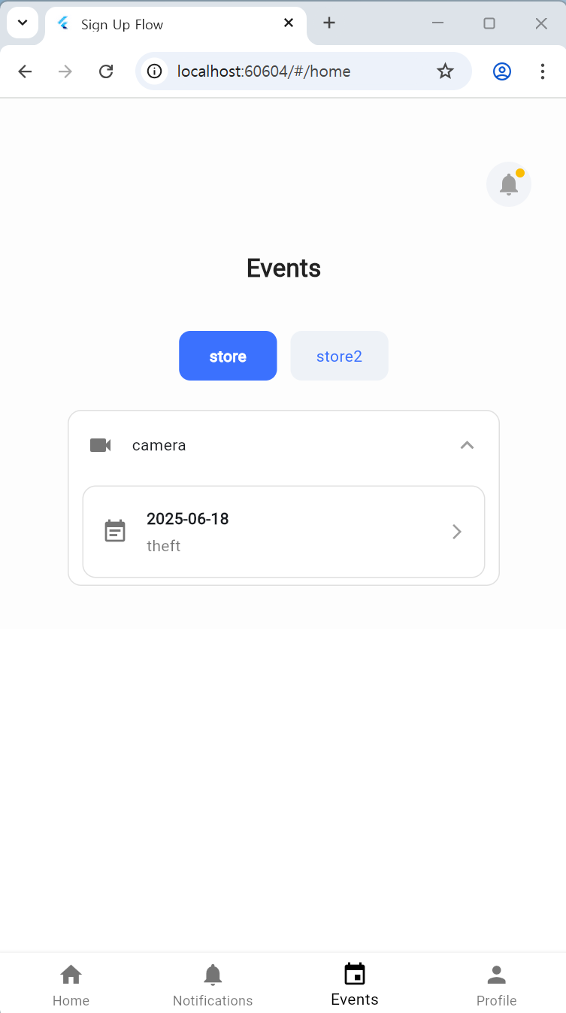
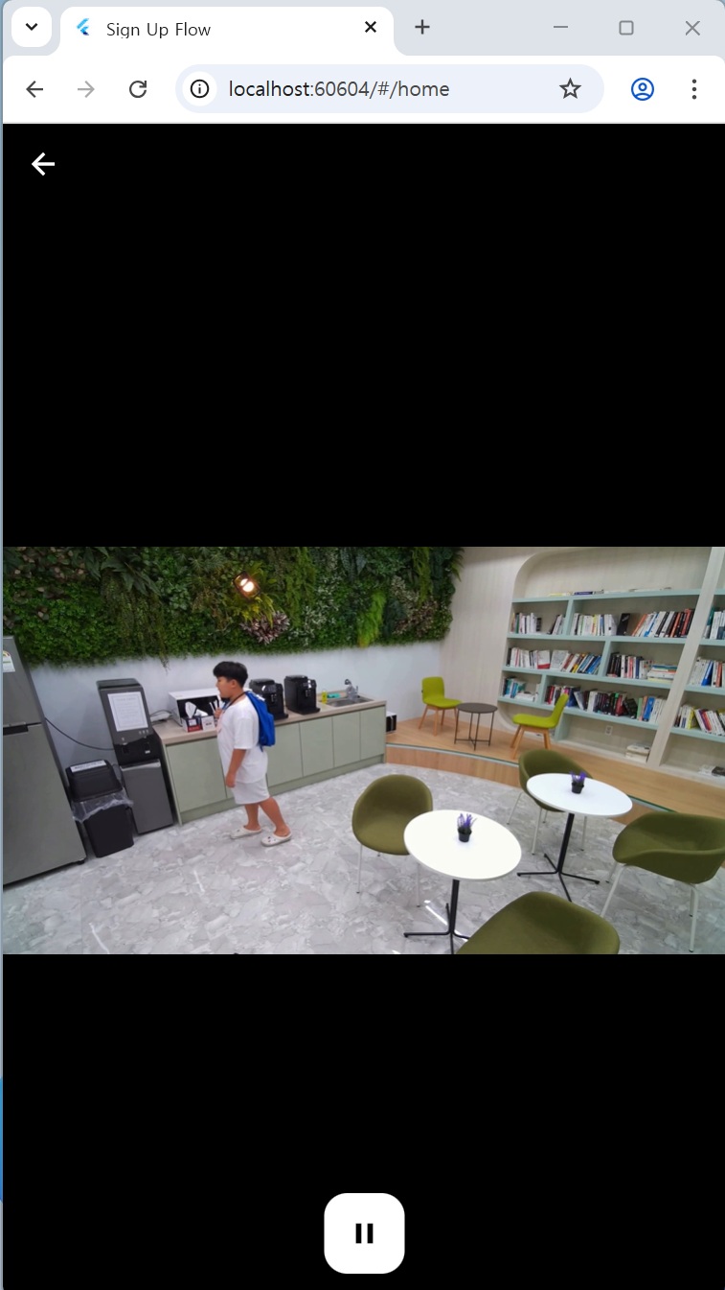
Application - Events

Slide 29
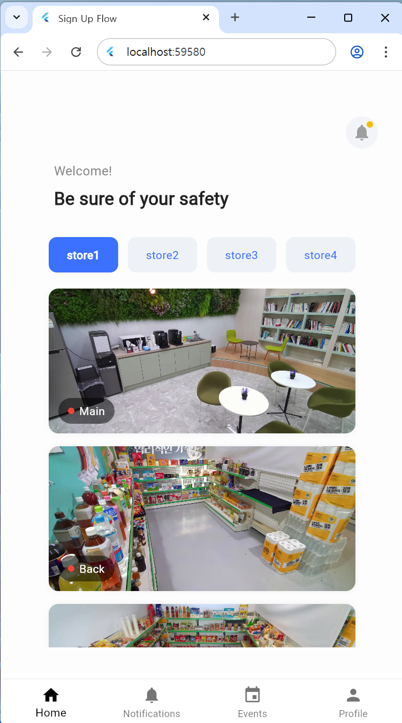
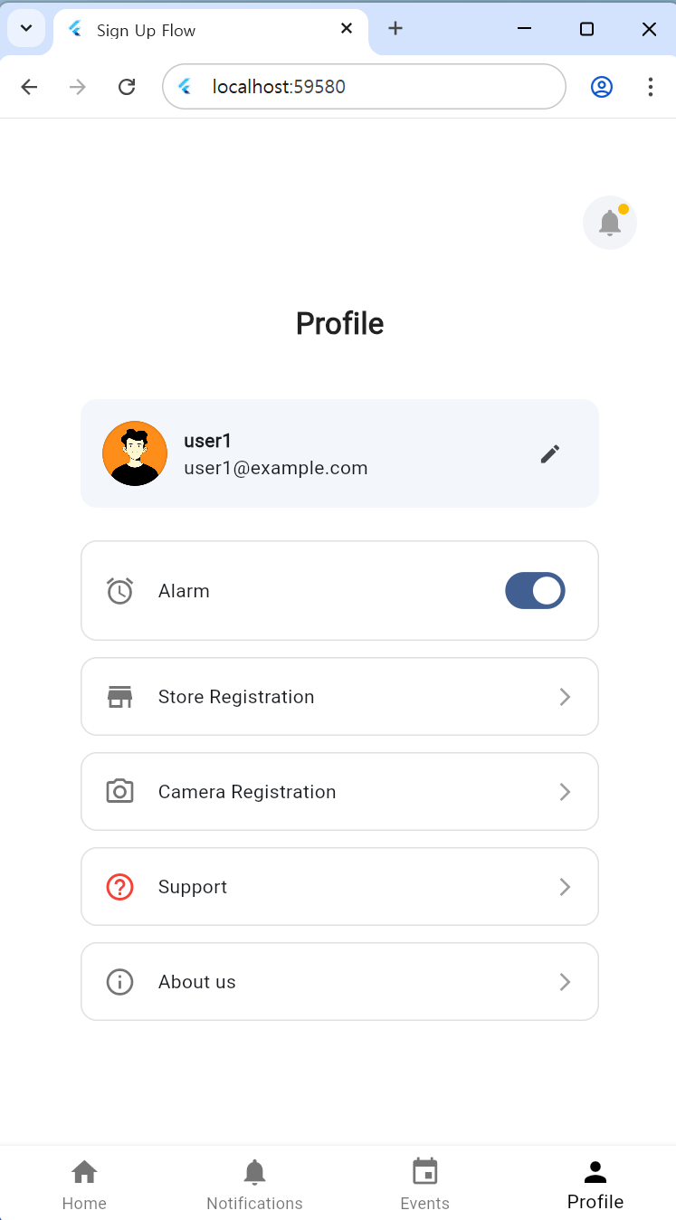
Application - Users

Slide 30

Application

Slide 31
Thank you!

